Slide 1
CSE315:Introduction to Data Science Fall 2024
Bivariate Analysis: Correlation and Simple Linear Regression Analysis
WEEK-4
Lesson 1

Slide 2
Correlation and Regression Analysis
Bivariate data: A dataset is said to be bivariate if the values ​​of two variables are observed from an individual.
Examples: Height and weight of students, supply and demand of a particular commodity, temperature and breakdown rates of electronic components, etc.
Question: Is there any relationship between the temperature and the breakdown rate of an electronic component? (yes, higher the temp higher the breakdown rate)
If a relationship exists, how strong is the relationship?
The correlation coefficient measures the strength of the linear relationship between bivariate observations.

Slide 3
Related terms of correlation and regression
Related terms used in bivariate analysis:
Dependent variable: The variable that is being predicted or estimated.
Independent variable: The variable that provides the basis for estimation.
Scatter plot: The diagrammatic way of representing bivariate data. It includes direction and type of relation, strength, slope or rate of response Outliers can be detected from scatter plot.
Covariance measures the linear relationship between two variables. A positive(negative) value indicates an increasing (decreasing) linear relationship. Under usual notations, the sample covariance for the n pairs is
Covariance has units of measurements and It cannot be used for comparison.

Slide 4
Correlation coefficient
We use the correlation coefficient instead of covariance to compare the strength of the relationship among pairs of variables because covariance depends on the units of measurement.
Correlation coefficient: Measures the strength of the linear relationship between two variables. The sample correlation coefficient for the n pairs is
r =1 if and only if all (xi,yi ) pairs lie on a straight line with a positive slope, and r = -1 if and only all (xi,yi ) pairs lie on a straight line with a negative slope.
A useful rule of thumb is that a relationship exits if |r|≥ (2/√n).

Slide 5
Linear Regression Model
Regression: measures the probable movement of one variable in terms of another.
General form of a linear equation (Multiple linear regression):
, (y- dependent and x's-independent variables).
The estimated regression equation for a set of n data points (with one independent variable) is , where, , and
Coefficient of determination: is the percentage of total variation in the observed y-values that are explained by the regression. ; Values of near zero indicate that the regression equation is not very useful for making predictions and values of near 1 indicate that the regression equation is extremely useful for making predictions. We add more relevant independent variables in the linear regression model when is low (multiple reg. arises)

Slide 6
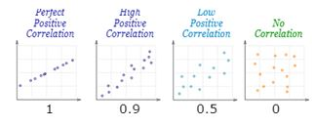
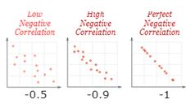
Scatter plots with interpretation
Linear correlations can be classified according to their direction (positive, negative) and their strength (none [0], weak, moderate, strong, perfect [1]).
Correlation coefficient value, r | Direction and Strength of relationship
-1 | Perfectly negative
-0.8 | Strongly negative
-0.5 | Moderately negative
-0.2 | Weekly negative
0 | No association
0.2 | Weekly positive
0.5 | Moderately positive
0.8 | Strongly positive
1 | Perfectly positive

Slide 7
Problem (modified) on Reg. and Corr (Ref. Lind, Ch 13, Exercise 6, pp- 444)
The owner of Maumee Motors wants to study the relationship between the car's age (yrs) and its selling price($1000). Below is a random sample of 12 used cars sold at Maumee Motors last year.
a. If we want to estimate the selling price based on the car's age, which variable is the dependent variable, and which is the independent variable? b. Draw a scatter diagram. Comment on it. c. Determine the coefficient of correlation. d. Determine the coefficient of determination. e. Interpret these statistical measures. Does it surprise you that the relationship is inverse? f. Determine the regression equation. g. Interpret the regression equation. h. Estimate the selling price of a 10-year-old car.
Age (years) x | Sell Price y ($1000)
9 | 8.1
7 | 6
11 | 3.6
12 | 4
8 | 5
7 | 10
8 | 7.6
11 | 8
10 | 8
12 | 6
6 | 8.6
6 | 8

Slide 8
Solution of the correlation and regression problem
Solution:
To answer the above questions, we need the following:
Scatter diagram
a - Intercept of the estimated regression equation of
b - Regression coefficient or slope of
r - Correlation coefficient.
From computer output or using a scientific calculator, we obtain the following values:
r = −0.544; a =11.18; and, b = −0.479
Therefore, the estimated regression equation is

Slide 9
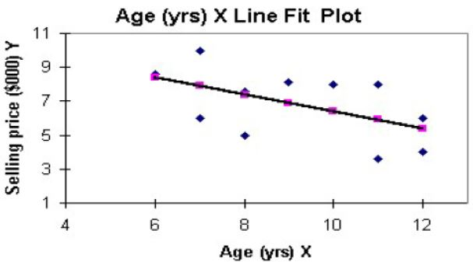
Solution of the correlation and regression problem (cont)
a) As we want to estimate, the selling price is the dependent/response variable, and age is the independent variable we use to estimate the selling price.
b)Figure: Scatter diagram between ages and selling prices of 12 cars
The scatter diagram indicates a moderate negative LINEAR relationship between age and the car's selling price. The relationship is negative because, as one variable (age/selling price) increases, the other variable (selling price/age) decreases.

Slide 10
Caution!!! The Following calculation table is for reference only!! students are advised to calculate the values of a, b, and r by scientific calculator
Age_x | SellPr_y
9 | 8.1 | 0.0833 | 1.191667 | 0.0069 | 1.4200695 | 0.09930555
7 | 6 | -1.9167 | -0.90833 | 3.6736 | 0.8250694 | 1.74097222
11 | 3.6 | 2.0833 | -3.30833 | 4.3403 | 10.945069 | -6.89236109
12 | 4 | 3.0833 | -2.90833 | 9.5069 | 8.4584028 | -8.96736109
8 | 5 | -0.9167 | -1.90833 | 0.8403 | 3.6417361 | 1.74930556
7 | 10 | -1.9167 | 3.091667 | 3.6736 | 9.5584028 | -5.92569446
8 | 7.6 | -0.9167 | 0.691667 | 0.8403 | 0.4784028 | -0.63402778
11 | 8 | 2.0833 | 1.091667 | 4.3403 | 1.1917361 | 2.27430556
10 | 8 | 1.0833 | 1.091667 | 1.1736 | 1.1917361 | 1.18263889
12 | 6 | 3.0833 | -0.90833 | 9.5069 | 0.8250694 | -2.80069443
6 | 8.6 | -2.9167 | 1.691667 | 8.5069 | 2.8617361 | -4.93402779
6 | 8 | -2.9167 | 1.091667 | 8.5069 | 1.1917361 | -3.18402779
 |  |  |  | 54.917 | 42.589167 | -26.2916667

Slide 11
Solution of the correlation and regression problem (cont)
e) Interpretation of c) and d).
The correlation coefficient, r = -0.544, indicates a moderate negative LINEAR relationship between age and car selling price. The relationship is INVERSE because, as one variable (age/selling price) increases, the other variable (selling price/age) decreases.
The coefficient of determination, = 0.2959 ≈ 0.30 , indicates the car's age can explain about 30% of the variation in selling price, and about 70% is left unexplained due to other variables.

Slide 12
Solution of the correlation and regression problem (cont)
f) The estimated regression equation is
g) Interpretations of the statistical measures a and b,
a (intercept) = 11.18 indicates that the average selling price of a brand-new car is 11.18 units = 11.18 x 1000=$11180.
Regression coefficient, b:
b= -0.479 indicates that the average selling price decreases yearly by
0.477x1000=$479.
h) The estimated selling price of a 10-year-old car is

Slide 13
Final note on Covariance
Covariance indicates the direction of the linear relationship between bivariate observations, while correlation measures the strength and direction of the linear relationship between bivariate observations. Correlation is a function of the covariance. Covariance has units of measurement, while the correlation coefficient is a pure number. We use the correlation coefficient for comparison. For the preceding problem:
In multivariate cases, we use covariance matrix to estimate parameters and/or models which also Known as dispersion matrix and variance-covariance matrix.

